Slide 1

Dynamics of trust between project-based firms and suppliers
Towards the dynamics of trust in the relationship between project-based firms and suppliers. © 2019 Cengage. International Journal of Project Management 39 (2021) 32–44

Slide 2
Objective
Inter-organisational projects focus on relationships and their dynamics.
Trust is key factor for success.
Relationship and trust are not static.
Structuration theory.
Dynamically reproduce and develop trust.
Towards the dynamics of trust in the relationship between project-based firms and suppliers. © 2019 Cengage. International Journal of Project Management 39 (2021) 32–44

Slide 3
Theoretical Background
Inter-organizational trust and relationships in project studies
The foundations and dynamics of trust: a structural view
Towards the dynamics of trust in the relationship between project-based firms and suppliers. © 2019 Cengage. International Journal of Project Management 39 (2021) 32–44

Slide 4
Inter-organizational trust and relationships in project studies
A relationship can be interpersonal or inter organizational.
Relationships are temporary.
Relational contracting.
Trust must be present in different levels of organizations.
Sleeping relationships.
Managing relationships between project firms and supplier.
We know very little about trust.
Towards the dynamics of trust in the relationship between project-based firms and suppliers. © 2019 Cengage. International Journal of Project Management 39 (2021) 32–44

Slide 5
The foundations and dynamics of trust: a structural view
Ontological security
Understanding the reproduction and development of trust is necessary.
Strategic partner suggests a particular form of relationship.
Structures of domination.
Dimensions of action include communication, power and norms.
Towards the dynamics of trust in the relationship between project-based firms and suppliers. © 2019 Cengage. International Journal of Project Management 39 (2021) 32–44

Slide 6
Methodology and methods
Research design
Case background
Data collection
Data analysis
Analysis strategy
Analysis process
Towards the dynamics of trust in the relationship between project-based firms and suppliers. © 2019 Cengage. International Journal of Project Management 39 (2021) 32–44

Slide 7
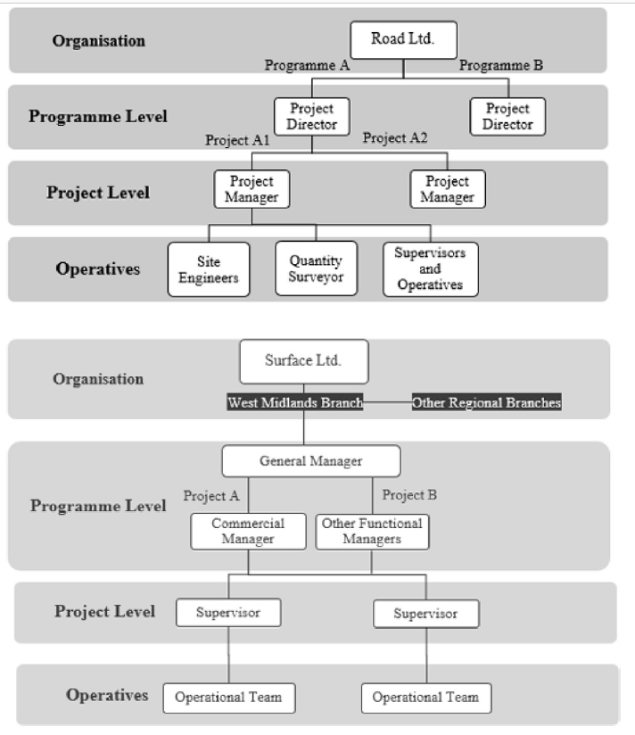
Road Ltd. Main contractor
Surface ltd. Sub contractor
Towards the dynamics of trust in the relationship between project-based firms and suppliers. © 2019 Cengage. International Journal of Project Management 39 (2021) 32–44

Slide 8
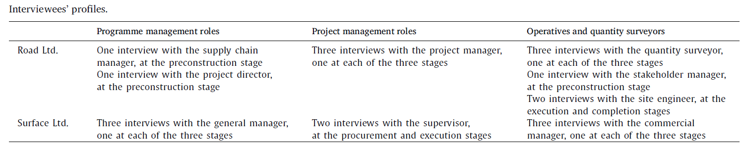
Data Collection
Data was collected from both parties in real time.
Semi structured interviews were conducted.
focus was on the detailed relationship within the focal project in the shadow of past .
Towards the dynamics of trust in the relationship between project-based firms and suppliers. © 2019 Cengage. International Journal of Project Management 39 (2021) 32–44

Slide 9
Data Analysis
Analysis strategy
Iterative process
Scope of original research project is limited to longitudinal analysis.
Analysis Process
Constructing a Chronological history of case.
Themes were uncovered that influenced trust at different stages of project.
First order themes.
Second order themes.
Towards the dynamics of trust in the relationship between project-based firms and suppliers. © 2019 Cengage. International Journal of Project Management 39 (2021) 32–44

Slide 10
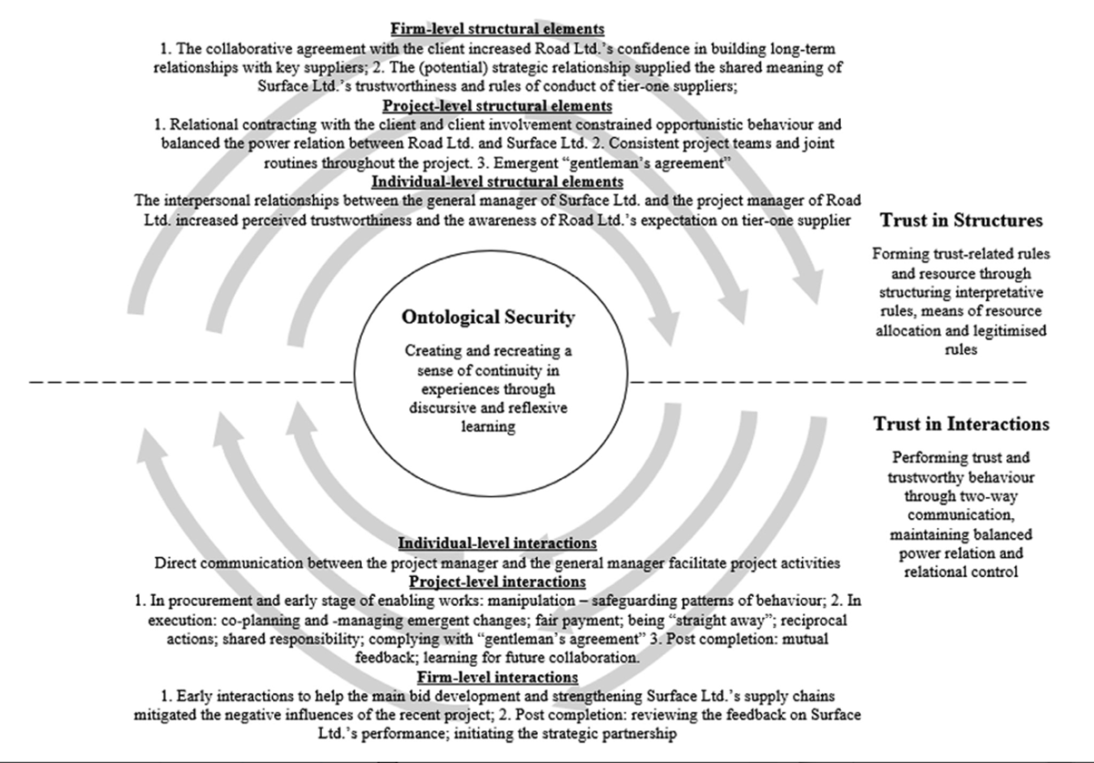
Findings
Relational arrangements at multiple levels

Slide 11
Ontological security
Creating and recreating a sense of continuity in experiences through discursive and reflexive learning.
Trust in structures
Forming trust-related rules and resources.
Structuring perceived trustworthiness as shared interpretative schemes
Structuring trust-related norms
Structuring trust as means of resource allocation
Towards the dynamics of trust in the relationship between project-based firms and suppliers. © 2019 Cengage. International Journal of Project Management 39 (2021) 32–44

Slide 12
Trust in interactions
Performing trust and trustworthy behaviour through two-way communication, maintaining balanced power relation and relational control
Balanced power
Tow-way communication
Relational control
Towards the dynamics of trust in the relationship between project-based firms and suppliers. © 2019 Cengage. International Journal of Project Management 39 (2021) 32–44

Slide 13
Discussion
The current research shows that the combination between trust-enabling structures and interaction drives trust dynamics.
Furthermore, the study implies that consistency between structures and interactions, as well as throughout different levels of project settings, is required to reproduce and establish confidence in subsequent encounters.
This emphasizes the need of developing ties between the company and project levels in order to create and sustain a common atmosphere of trust in project management.
Towards the dynamics of trust in the relationship between project-based firms and suppliers. © 2019 Cengage. International Journal of Project Management 39 (2021) 32–44

Slide 14
Conclusion
The dynamics of inter-organizational trust in project contexts, namely the interaction between project-based business and supplier, were investigated in this study.
Additional research can be carried out to focus on trust dynamics in other project-based industries to promote analytical generalization of the concepts presented here
Towards the dynamics of trust in the relationship between project-based firms and suppliers. © 2019 Cengage. International Journal of Project Management 39 (2021) 32–44

Slide 15
THANK YOU !!

